Slide 1
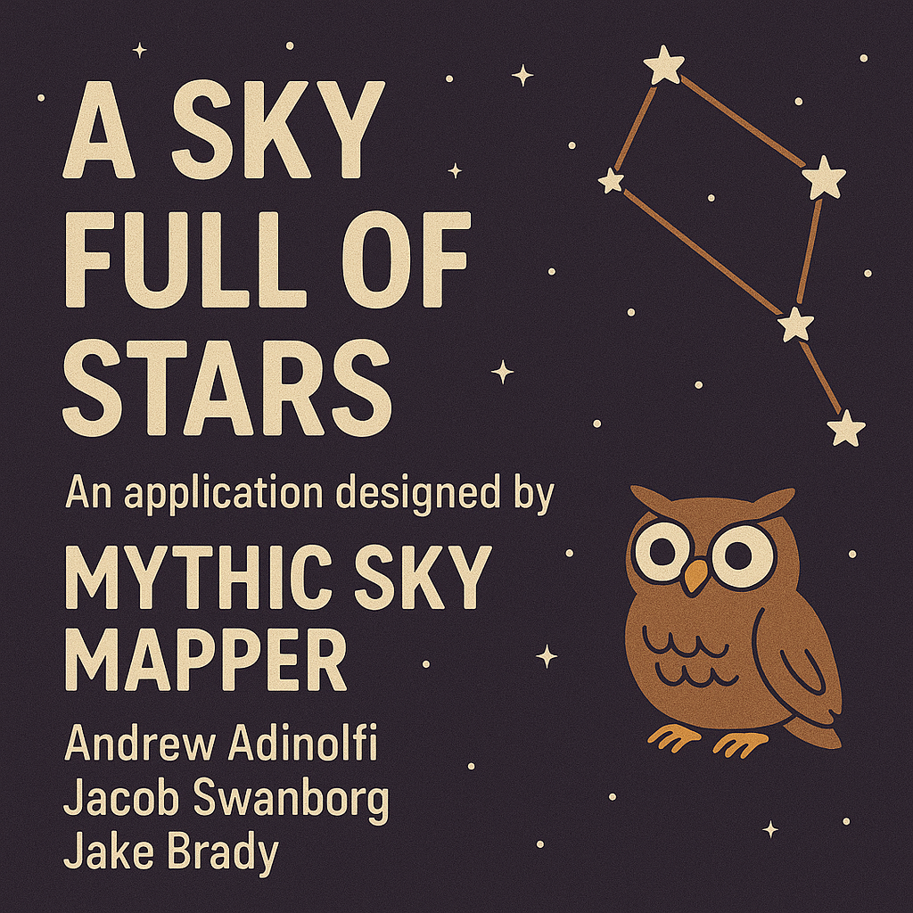

Slide 2
Agenda
Application description
Implementation
Demonstration
Evaluation
Conclusion

Slide 3
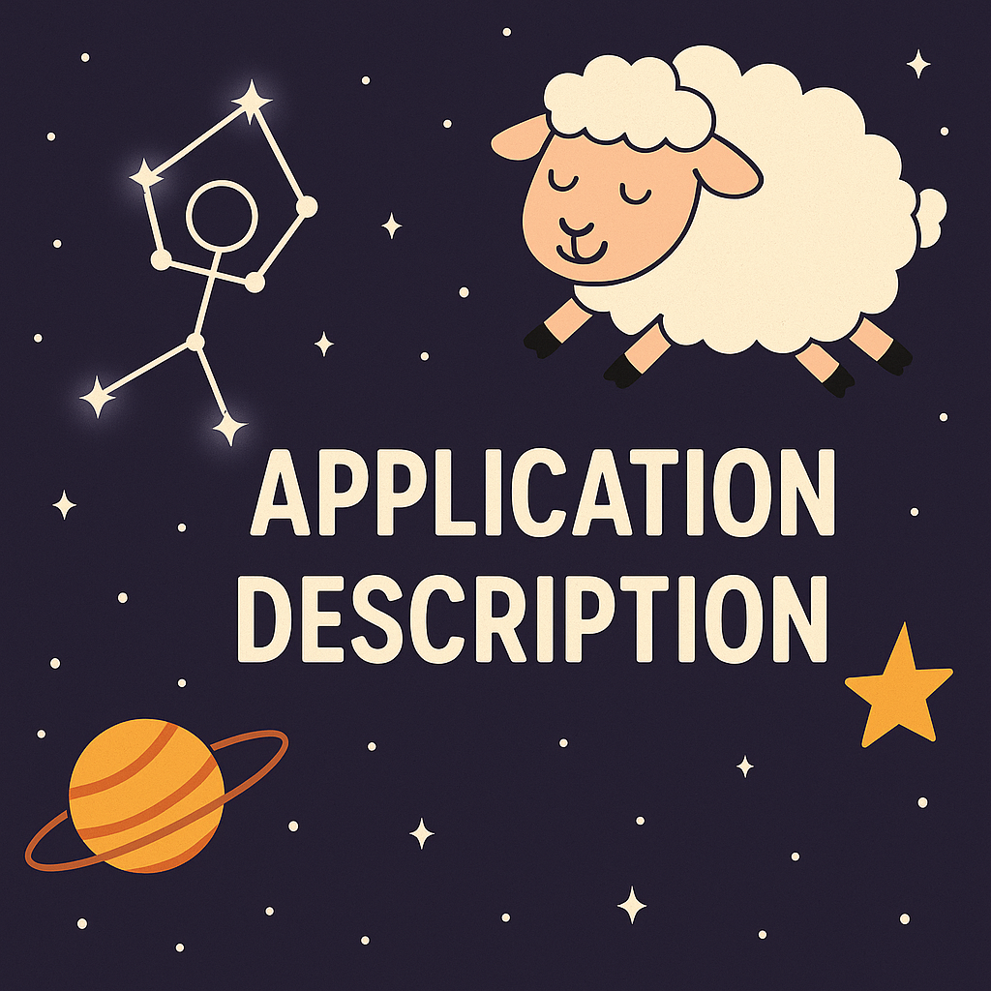

Slide 4
Functionality
Create custom constellations by selecting and connecting stars.
Save their designs for personal reference or editing.
Share constellations with friends or a broader community.
Explore existing constellations, both real and user-generated, with associated details.

Slide 5
Application Domain and Type of Applications
This application belongs to the astronomy-themed social and creative tools domain. It blends elements of learning science (understanding celestial patterns) with interactive, user-generated content.
Because why wouldn't you want to learn your horoscope?

Slide 6
Importance of having a database here
Store constellation designs, user profiles, and shared creations.
Maintain a library of star and constellation data for accurate rendering.
Track user interactions and shared creations.
Ensure scalability as more constellations and users are added over time.

Slide 7


Slide 8
Architecture
Using MySQL for the database backend
Using Python for the frontend
Using Pandas to add the data from the MySQL tables
Exclusively using stored procedures for communication

Slide 9
Dataset
Sloan Digital Sky Survey DR17 dataset available at: https://www.kaggle.com/datasets/fedesoriano/stellar-classification-dataset-sdss17/data
This dataset catalogues over 100,000 observations of stellar objects. We chose it because it is the most comprehensive freely available source of stellar data. Since it is so widely known the object IDs other sources of data are available referencing the same object IDs giving us some flexibility to expand if needed.

Slide 10
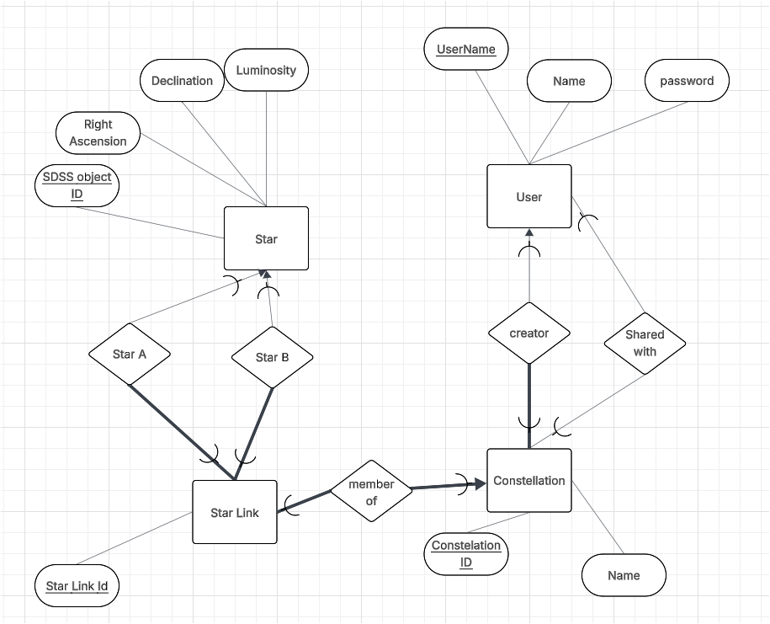
ER Model

Slide 11
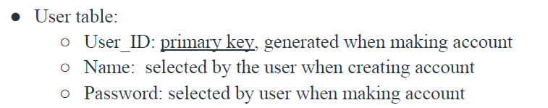
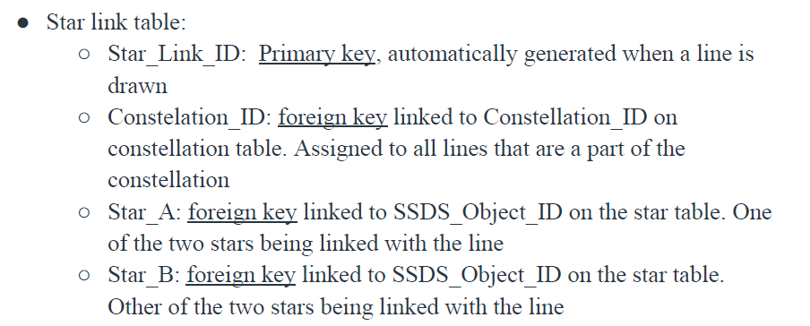
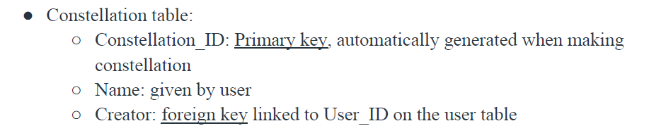
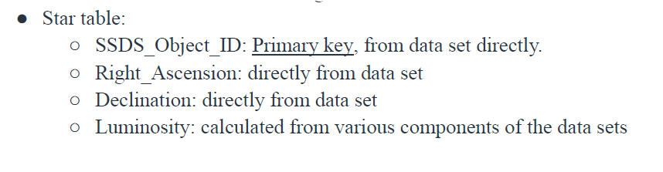
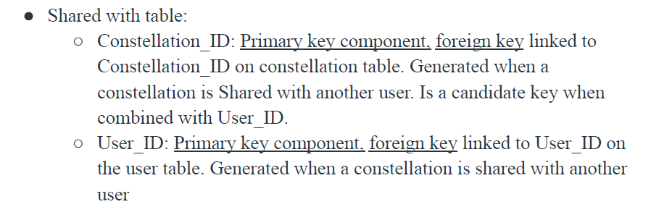
Relational Model

Slide 12
Star
CREATE TABLE Star(
SSDS_OBJECT_ID BIGINT,
Right_Ascension DOUBLE,
Declination DOUBLE,
Luminosity DOUBLE,
primary key(SSDS_OBJECT_ID));

Slide 13
User
CREATE TABLE User(
User_ID BIGINT,
Name varchar(255),
Password varchar(255),
primary key(User_ID));

Slide 14
Constellation
CREATE TABLE Constellation(
Constellation_ID BIGINT,
Name varchar(255),
Creator BIGINT,
primary key(Constellation_ID),
FOREIGN KEY(Creator) REFERENCES User(User_ID) ON UPDATE CASCADE);

Slide 15
Star_link
CREATE TABLE Star_link(
Star_Link_ID BIGINT,
Constellation_ID BIGINT,
Star_A BIGINT,
Star_B BIGINT,
primary key(Star_Link_ID),
FOREIGN KEY(Constellation_ID) REFERENCES Constellation(Constellation_ID) ON UPDATE CASCADE,
FOREIGN KEY(Star_A) REFERENCES Star(SSDS_Object_ID),
FOREIGN KEY(Star_B) REFERENCES Star(SSDS_Object

Slide 16
Shared
CREATE TABLE Shared(
Constellation_ID BIGINT,
User_ID BIGINT,
primary key(Constellation_ID, User_ID),
FOREIGN KEY(Constellation_ID) REFERENCES Constellation(Constellation_ID) ON UPDATE CASCADE,
FOREIGN KEY(User_ID) REFERENCES User(User_ID) ON UPDATE CASCADE);

Slide 17


Slide 18
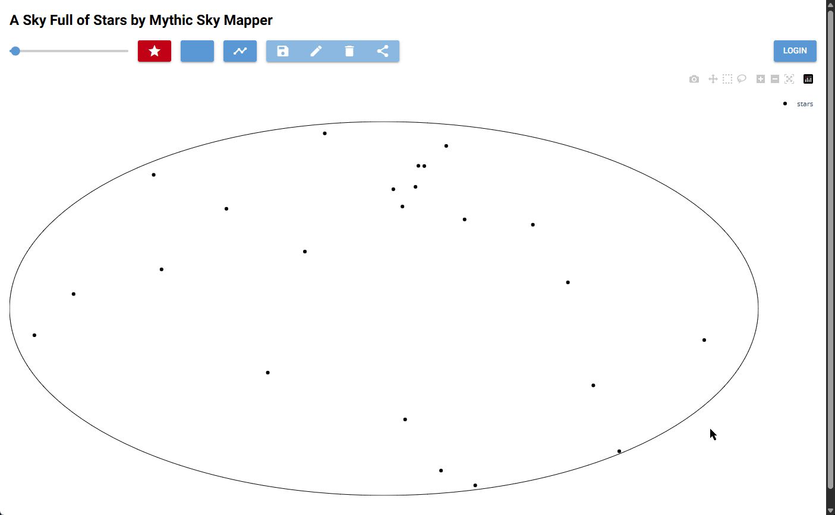
Selecting stars

Slide 19
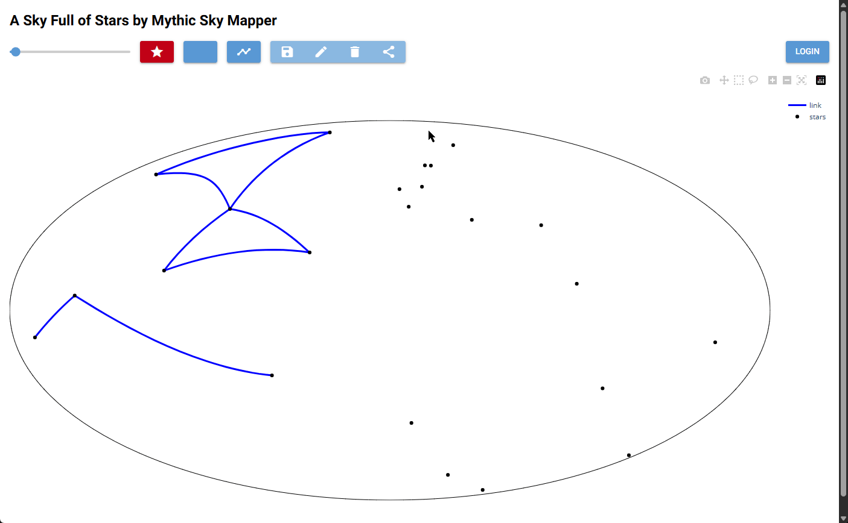
Controlling the UI

Slide 20
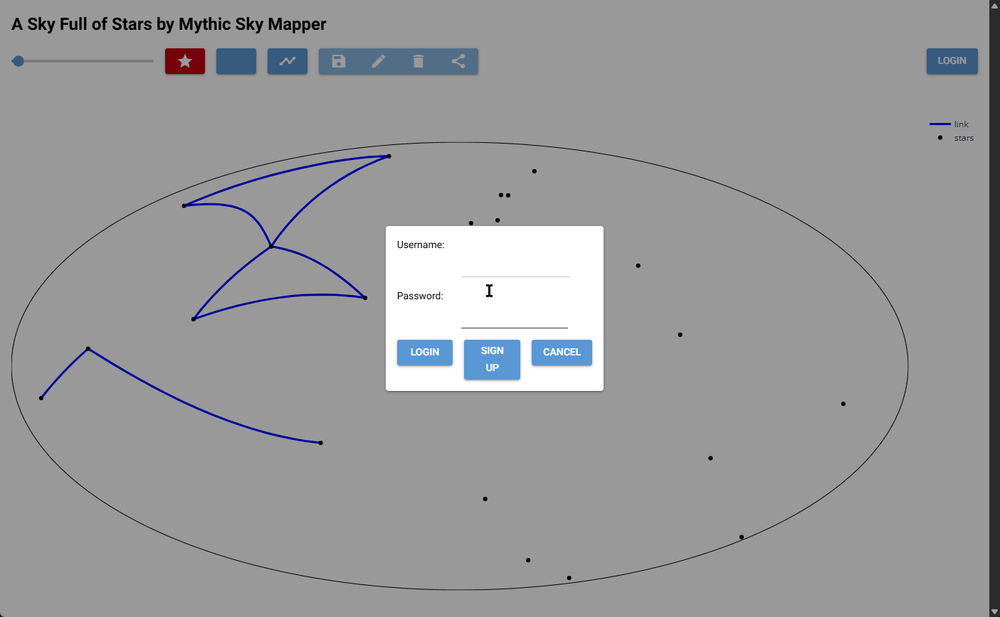
Signing up for an account

Slide 21

Logging in

Slide 22
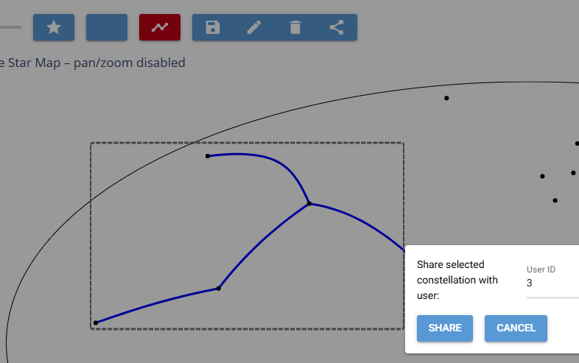
Share constellation with another user

Slide 23


Slide 24

Test Case 1: Attempt To Check Password

Slide 25
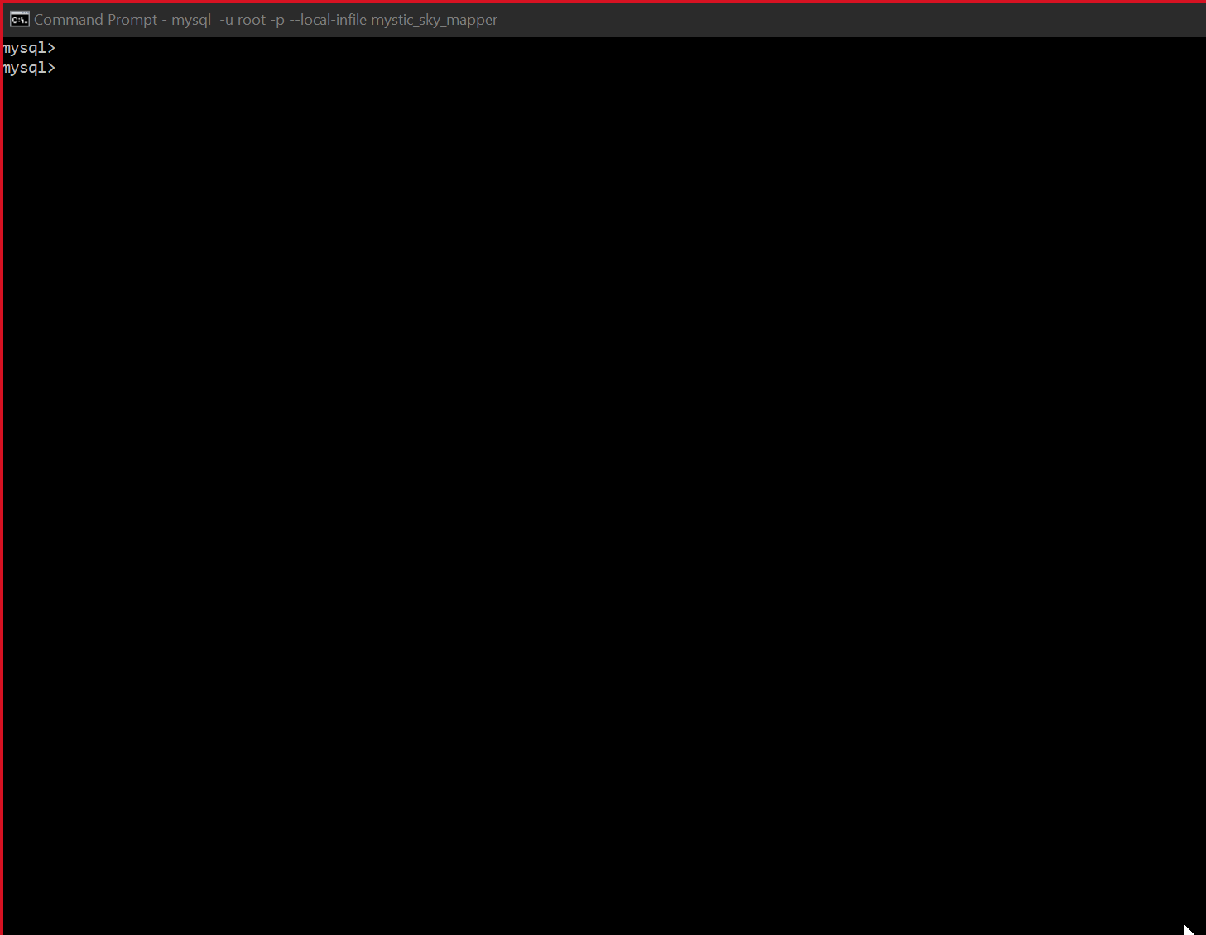
Test Case 2: Creating a Constellation

Slide 26
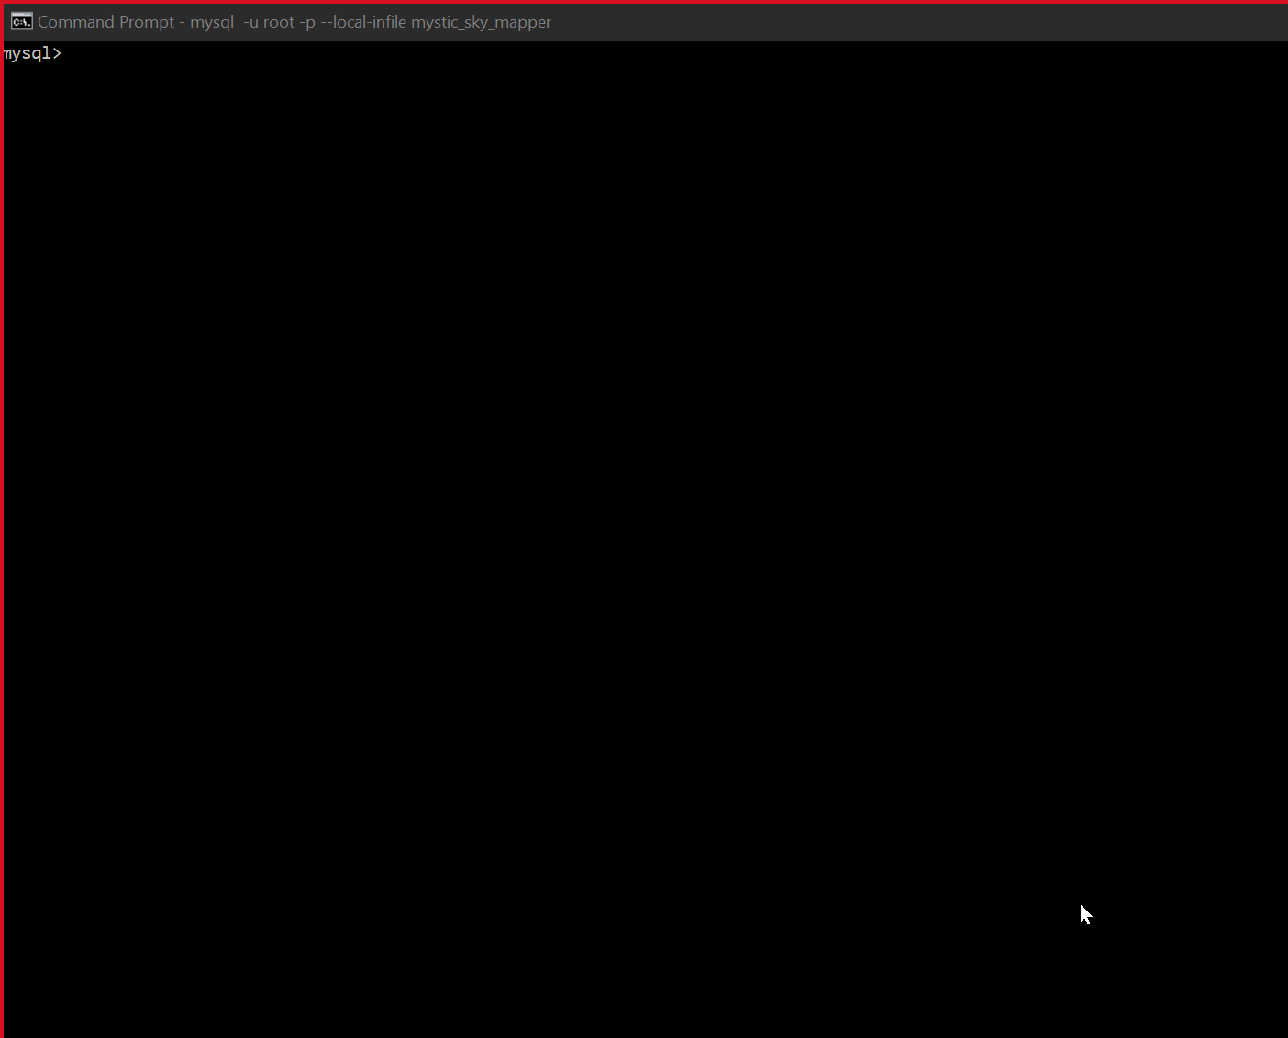
Test Case 3: Making a Star Link

Slide 27
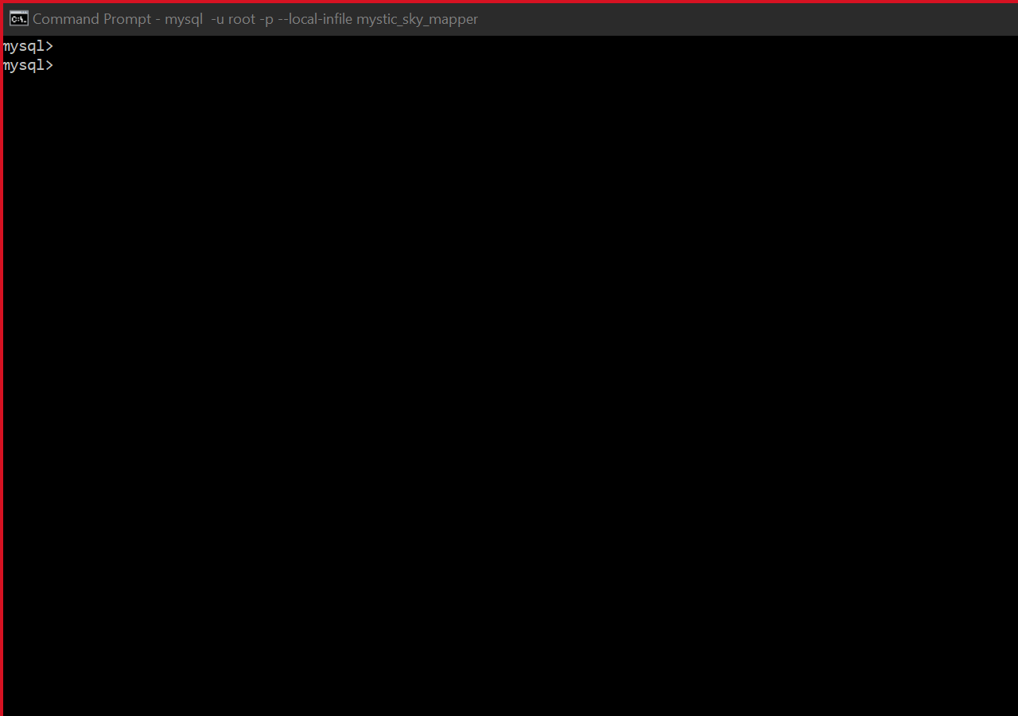
Test Case 4 Sharing and Un-sharing a Constellation

Slide 28
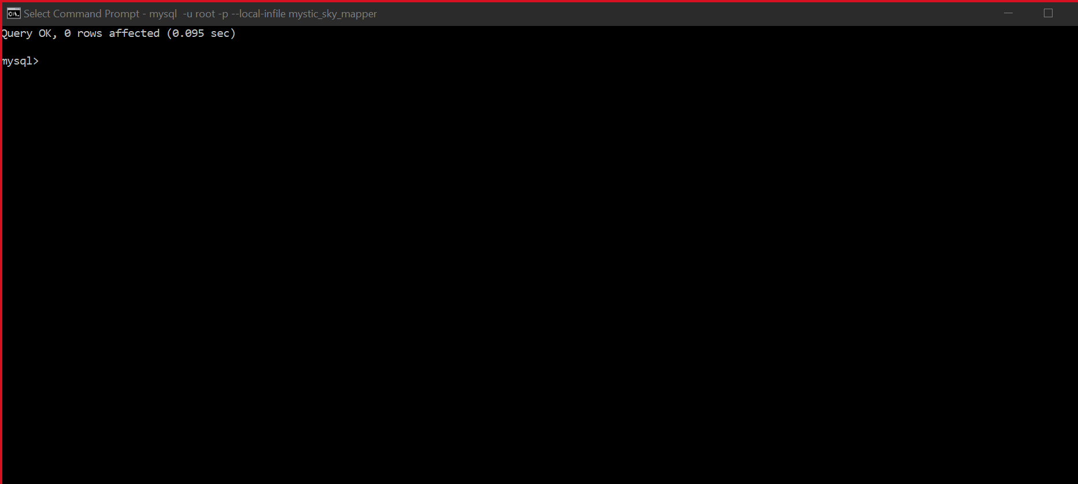
Test Case 5: Getting the Links in a Constellation & Deleting the Constellation

Slide 29
Conclusion
Python UI is tricky, especially when implementing with a SQL backend
Having a rough understanding of the structure and refining that structure into a fully usable set of stored procedures requires different levels of effort.
It's a delicate balance deciding what to store locally and what/when to store in the database.

Slide 30
Q+A?
Coldplay - A Sky Full Of Stars (Official Video)

